Slide 1

Vehicle Management System
KIET Group Of Institution
(Department of Computer Application)

Slide 2
Project Scope
Registration for new users will be available on the login page and registration for employees can be done by Admin only. And driver registration can be done by both admin & employee. In Login Page, enter username and password which will be further authenticated and recognize their username as admin, Employee, Driver or User accordingly functional window will open.
In the Profile module an admin can add new users to the database. He can set the details of the staff and the users also, while users and employees will only be able to see their details and update the information in this module. Only the admin can add or drop the users.
In Vehicles modules, all the vehicles are listed there. Every user has the privilege to add vehicles and all of them can view the available vehicle. They can also book the available vehicles from there but only the admin can delete vehicles from the list.

Slide 3
Functional Requiements
In this functionality the administrator will do his own responsibilities. Whenever he needs to change the Password, then he can directly change it. If any reason he needs to add a new user he can directly add.
The admin user can view the details of all the users and he can add or remove any particular users. He can view the details of all the employees of the company and any time he can add or remove any particular employee or employees.
This application mainly concentrated on transport. The admin user can view the details of all the categories of the transport. This category’s viewing list shows the ID Number of the category, category code, how much amount per month, and how much distance allotted for the particular category, all this information will be provided.

Slide 4
Non Functional Requirement
1. Availability
The system shall be available during normal hotel operating hours
2. Correctness
Extent to which program satisfies specifications, fulfils user’s mission objectives
3. Efficiency
How much smaller the number of resources and time are required to achieve a particular task through the system.
4. Flexibility
Ability to add new features to the system and handle them conveniently.
5. Integrity

Slide 5
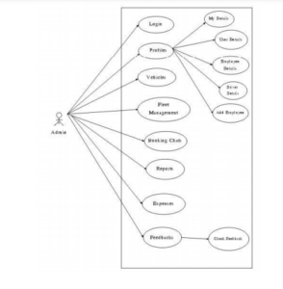
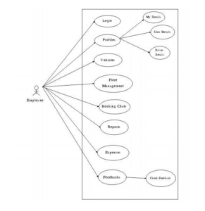
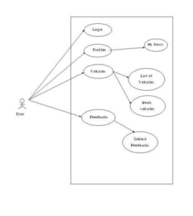
Case Study Diagram

Slide 6
Development Enviorment
1. Hardware Requirement
The minimum requirements needed to perform operations are Intel Pentium Processor at 2 GHz or Higher, RAM 256MB or more, Hard disk capacity 10GB or more.
2. Software Requirements
The software required to perform the implementation are Windows or Linux Operating System (Ubuntu, Fedora), JDK 8, Eclipse / NetBeans IDE, The Diagram Editor, Visual Studio Code.

Slide 7
Future Scope
Bookings in this application could be extended to Freight and Transportation
bookings.
Mobile Application could be developed for the system to reach out to more users.
Google Map Integration will add vehicle security while reducing illegal use of
company vehicles.

Slide 8
Thank You ..

